Slide 1

CREDIT CARD FRAUD DETECTION
Anahit Shekikyan, Marinela Inguito, and JasonTong

Slide 2

The Problem: Real-Time Detection of Credit Card Fraud
Why this is an issue?
Increase in digital transactions - new opportunities for cybercriminals
Cost is $32 Billion annually and continues to rise
How it happens?
Theft through lost or stolen card
Credit card skimming at ATMs or card readers
Phishing scams by emails, text, and phone calls
Credit card account cloning
Who are affected?
Financial institutions: Financial costs, loss of reputation
Consumers: Financial loss, credit history impact, identity theft, loss of trust, stress

Slide 3

Current Detection Systems:
Struggle to keep up with evolving Fraudulent activity patterns
Fraud not detected (known as False Negatives)
Legitimate transactions flagged as fraud (known as False Positives)
Objective:
Enhance fraud detection system performance, benefitting both financial institutions and their customers
Reduction in financial institution’s loss, Increase in customer satisfaction and trust

Slide 4
DATA ANALYSIS
Data Exploration
Handling Imbalance
Data Preprocessing
Explore existing historical credit card fraud data. Data pre-transformed to protect account and identifying information.
Address severe class imbalance. Actual fraud is around 0.17 percent of transactions.
Preprocess data appropriately to handle duplicates, outliers
Model Evaluation
Approach
Fraud Detection Focus
Evaluate various machine learning models
Non-traditional approach, not focused on accuracy since might mislead by predicting mostly majority class of non-fraudulent transactions.
Focus on the positive outcomes (fraudulent transactions) emphasizing performance on true positives (true fraud)

Slide 5
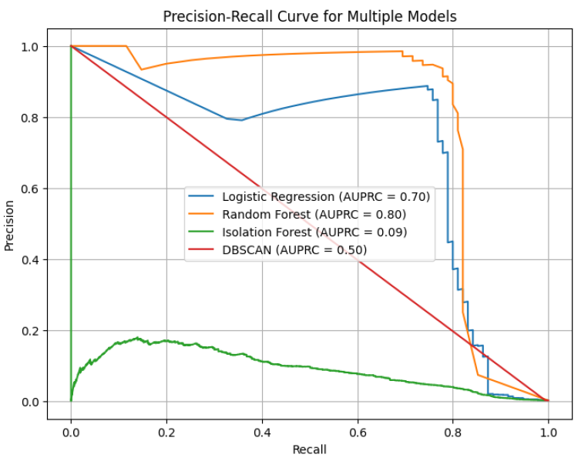
DATA ANALYSIS CONCLUSION
Best Performing: Random Forest Model
Good ability to identify large proportion of fraudulent transactions (known as Precision)
Good sensitivity (Recall), ratio of true fraudulent transactions to actual fraudulent transactions
Other Models:
Logistic Regression: poor ability to identify large proportion of fraudulent transactions
Isolation Forest and DBCSAN: overall poor performance

Slide 6
Recommendations
Continue to invest in Fraud Detection Technology: improve Random Forest model performance; explore other models
Reduce False positives
(transactions incorrectly identified as fraud)
to foster customer loyalty and trust
Monitor emerging fraud tactics to strengthen business vigilance and improve fraudulent detection system

Slide 7
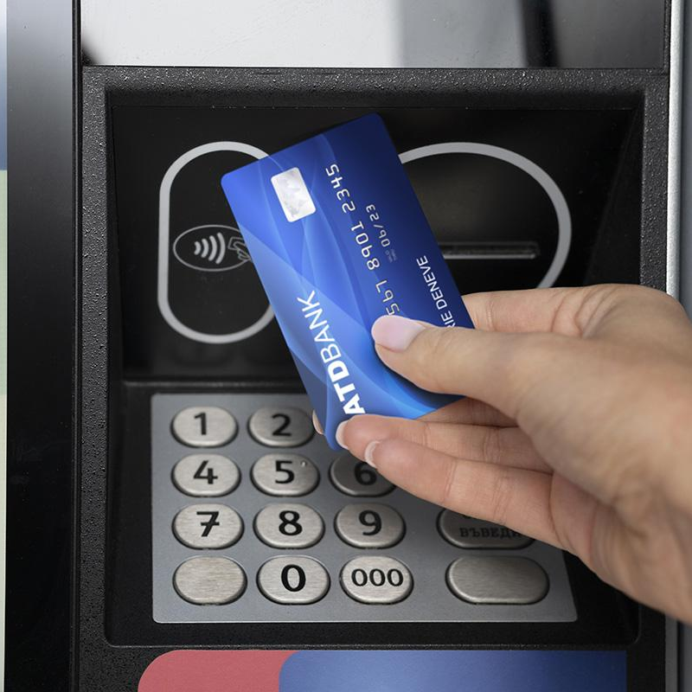
THANKS
Do you have any questions?
ashekikyan@sandiego.edu
jasontong@sandiego.edu
minguito@sandiego.edu

Slide 8
References: Ferraro, A. (2024, May 13). Types of credit card fraud—Guidelines for recognizing and avoiding fraud. Privacy.com. https://privacy.com/blog/types-of-credit-card-fraud The Nilson Report. (2022a, December 22). Payment card fraud losses reach $32.34 billion. GlobeNewswire News Room. https://www.globenewswire.com/news-release/2022/12/22/2578877/0/en/Payment-Card-Fraud-Losses-Reach-32-34-Billion.html Shmueli, G., Bruce, P. C., Gedeck, P., & Patel, N. R. (2020). Data mining for business analytics: Concepts, techniques and applications in Python. Wiley.

